Slide 1
Dad! I Wanted to Ask You
why do you bow to a book

Slide 2
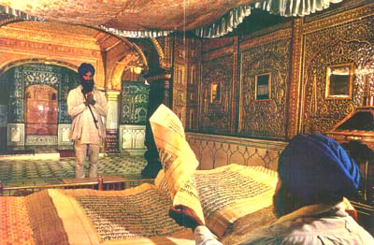
why do you bow to a book

Slide 3
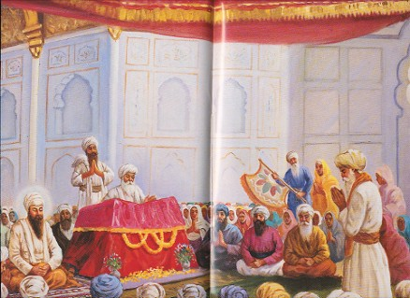
Father: Sonny, you must bow to Guru Granth Sahib.
I have been told that you have set a wrong example for other young Sikhs.
Son: Dad, I also wanted to ask you, why do you bow to a book.

Slide 4

Almost every day you remind me that medical subjects involve a lot of study but you never told me to bow to my books to become a doctor.
You know it well that one cannot become a doctor by bowing to medical books.

Slide 5

Similarly, how can I become a Sikh by bowing to the Sikh book.
Please, daddy, do not bow to the book.
It embarrasses me a lot.
You are an educated person and not an illiterate to do that.
Father: I told you that bowing is essential for a Sikh.

Slide 6

I visited the office in the federal government.
A white man came to see him.
He took off his hat and put his bare head before the face of your uncle.
I felt very mad at his misbehavior.
I wanted to talk to you guys and know what we can do about it.”

Slide 7

The boys laughed and tried to explain to me that it did not mean any disrespect.
Rather, the taking off of one’s hat shows respect for the other person.
Everyone had something to tell me about this western culture

Slide 8
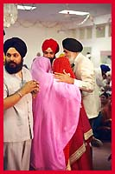
“I was comparing your culture with my culture.
Instead of presenting ourselves bareheaded before a senior and respectable person, we always appear with a turban on our head.
We fold our hands and bow to him to show respect for the elderly person.

Slide 9
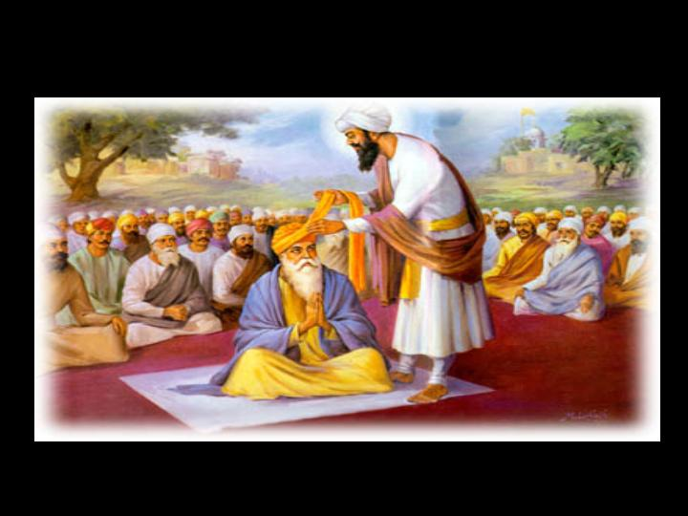
I was wondering if we practice your culture to show respect to Guru Granth Sahib, what a scene the gurdwara hall will become.
Every Sikh reaching near Guru Granth Sahib instead of bowing will take off his turban and start tying it again.
The hall will become a turban tying hall.”

Slide 10
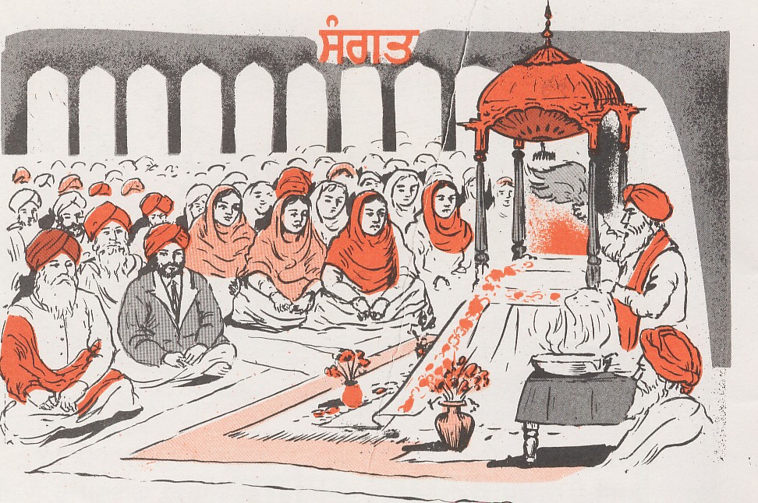
we must bow to Guru Granth Sahib.”

Slide 11
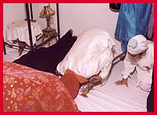
Son responded, “Yes. We do accept and respect the teachings of Guru Granth Sahib.
For that reason, we must bow to Guru Granth Sahib.”
“We do respect and accept the teachings of Guru Granth Sahib, therefore, we must bow to Guru Granth Sahib.”

Slide 12
Bye !

